Slide 1

DOCTOR’S CLINIC
Minor Project

Slide 2
THE TEAM
Sayandeep Mallick
Sayan Bhattacharya
Swastika Banerjee
8017015575
9831581099
7439632377
Ritwik Saha
Pritikana Mondal
Manisha Kumari
9330331836
7029302254
7477436903

Slide 3


OUR GOAL
Our software solves the complications coming from managing all the paper works of every patient and staff associated with the various departments of the hospital with confidentiality. HMS provides the ability to manage all the information in one place, reducing the work of staff in arranging and analyzing the paperwork and making processing information more efficient
OUR GOAL

Slide 4

SOFTWARE REQUIREMENT Specification
External Interface Requirements: -
3.2 Hardware requirements: -
• OS – windows XP ,10
• Hard disk – 80 GB
• RAM – 1 GB
• Keyboard – Standard QWERTY keyboard for interface
• Mouse – Standard mouse with 2 buttons
3.3 Software Interface: -
• Front end – Java language
• OS – Windows
• Back end – MySQL Server
• IDE – intellij IDEA
3.1 User Interface: -
User interface is designed in a user friendly manner and the user, in another end he has to give the order, for that he will interact using keyboard and mouse.

Slide 5
SOFTWARE REQUIREMENT Specification
FUNCTIONAL REQUIREMENTS: -
4.1 Admin Module: -
4.1.1 Patient Manager: -
4.1.2 F-Desk Manager:
4.1.3 Doctor Manager: -
4.1.3 Appointment
Manager: -
4.2 Front Desk Module: -
4.2.1 Patient Manager: -
4.2.2 Appointment
Manager
4.2.3 Doctor Finder: -
4.2.4 My Info: -
4.3 Doctor Module: -
4.3.1 My Appointment
4.3.2 My Information
4.3.3 View all patient

Slide 6
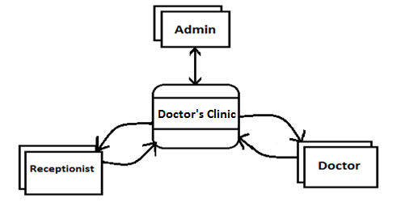
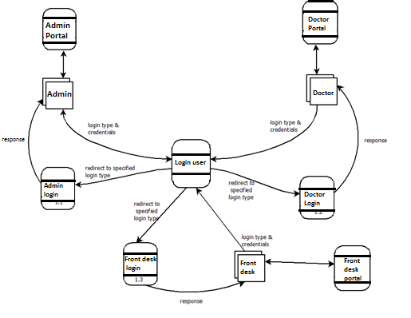
DATA FLOW DIAGRAM
1. Context Level Diagram (0 level)
2. Level 1 DFD of Login system
6

Slide 7
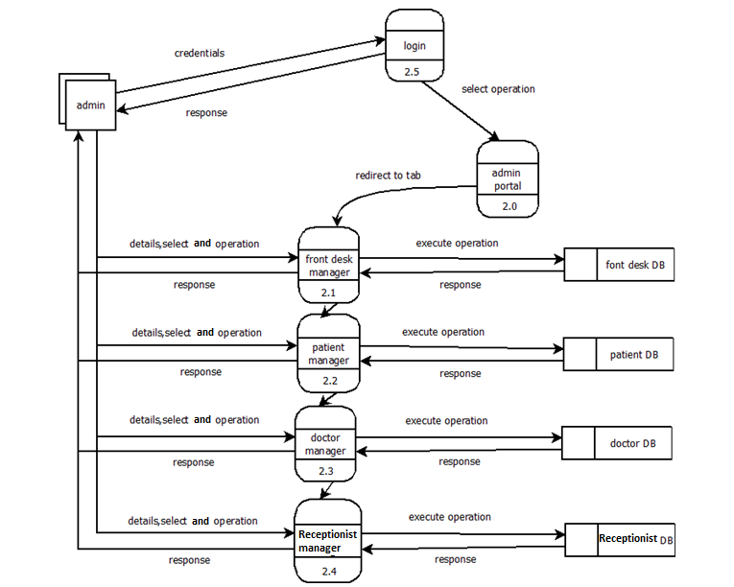
DATA FLOW DIAGRAM
3. Level 2 DFD of Admin Functionalities

Slide 8
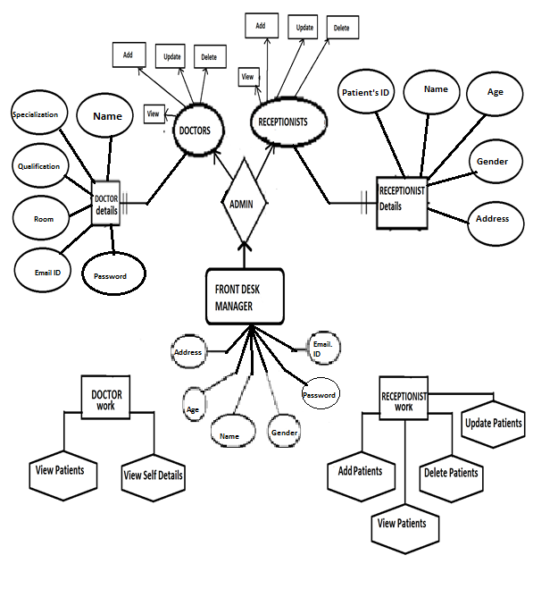

ENTITY RELATIONSHIP DIAGRAM

Slide 9
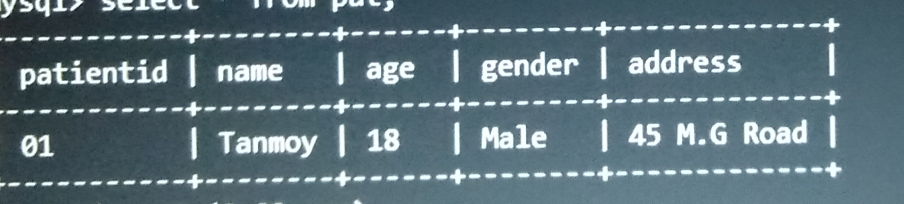
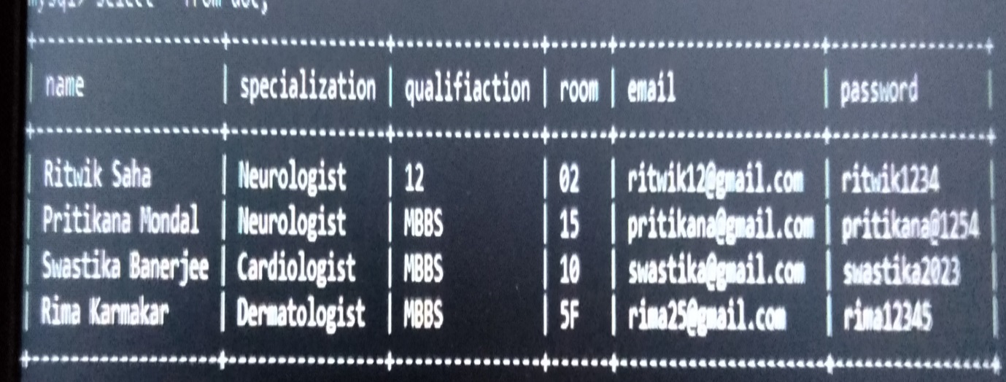
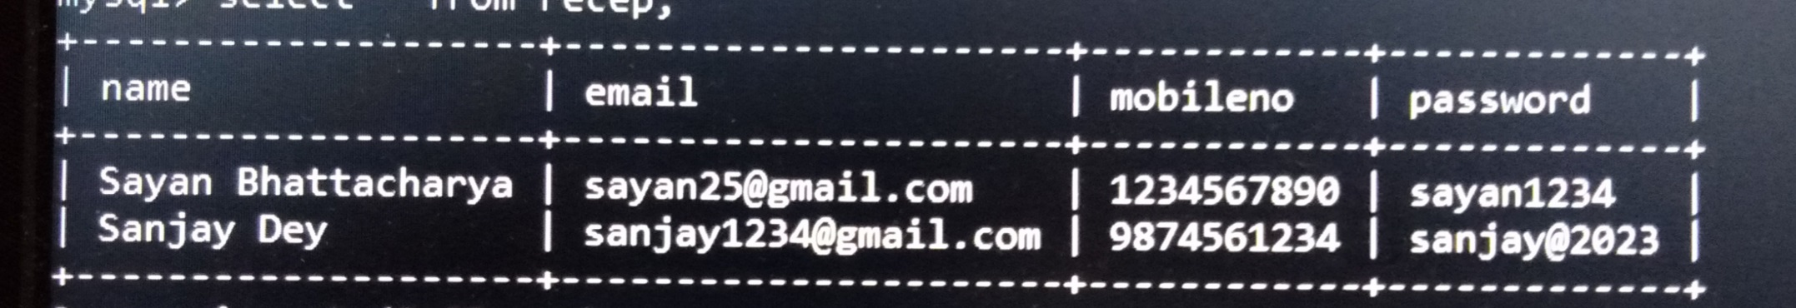
DATABASE
2. Doctor Database
1.Patient Database
3. Receptionist Databased

Slide 10
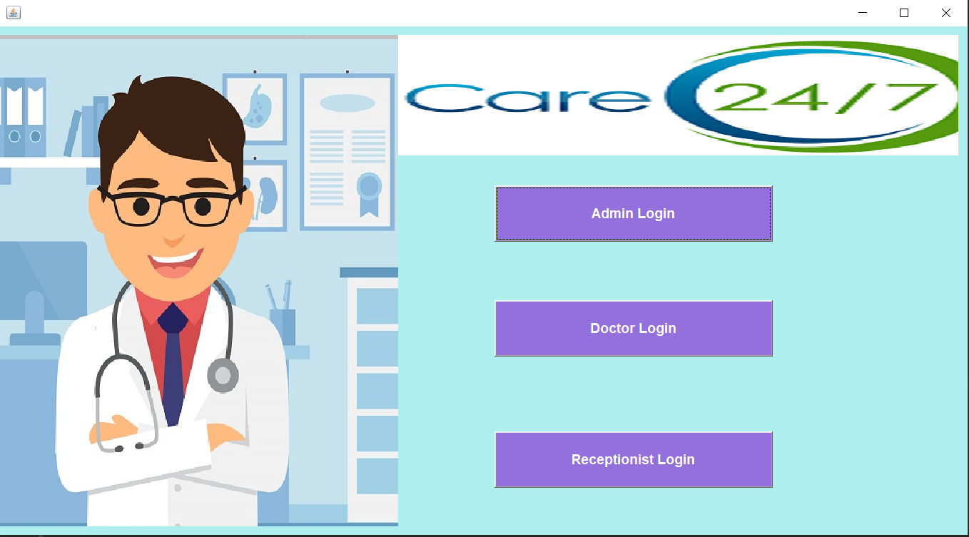
Screen Design
Home Page

Slide 11
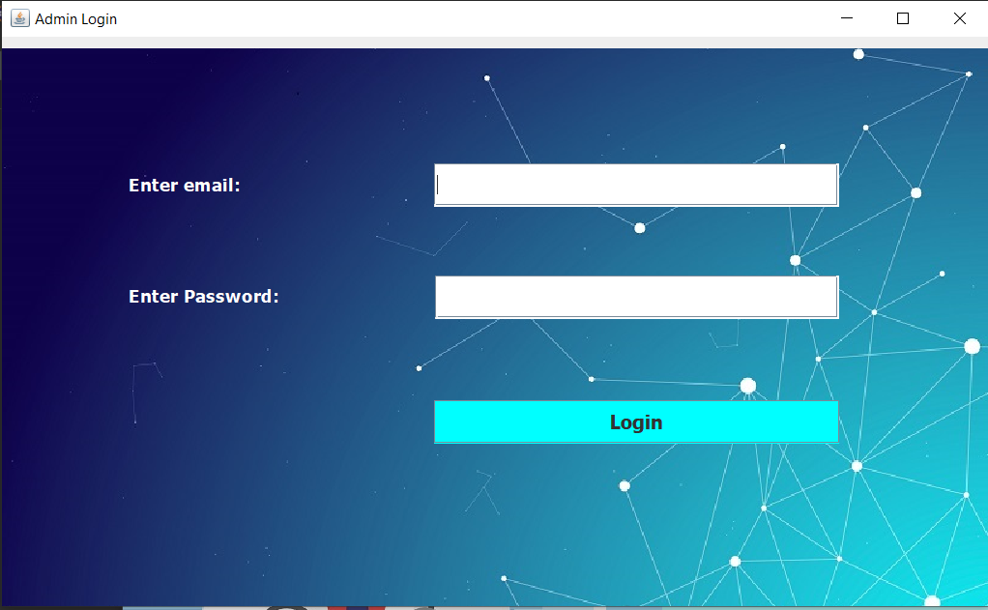
Screen Design
Admin login

Slide 12
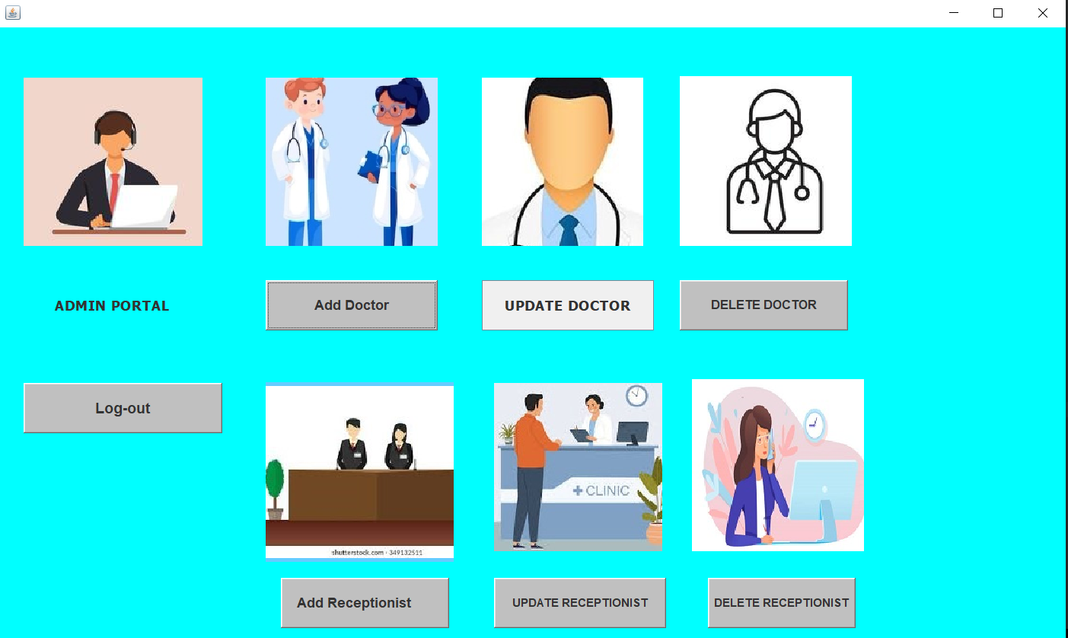
Screen Design
Admin panel

Slide 13
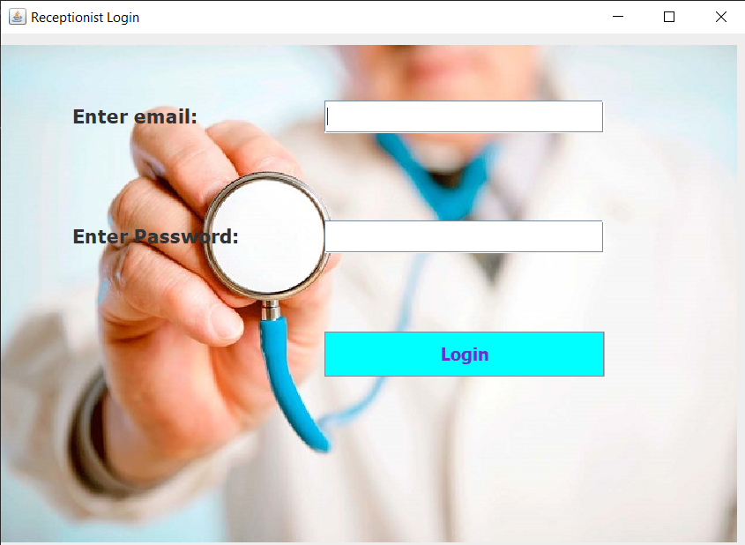
Screen Design
Doctor Login

Slide 14
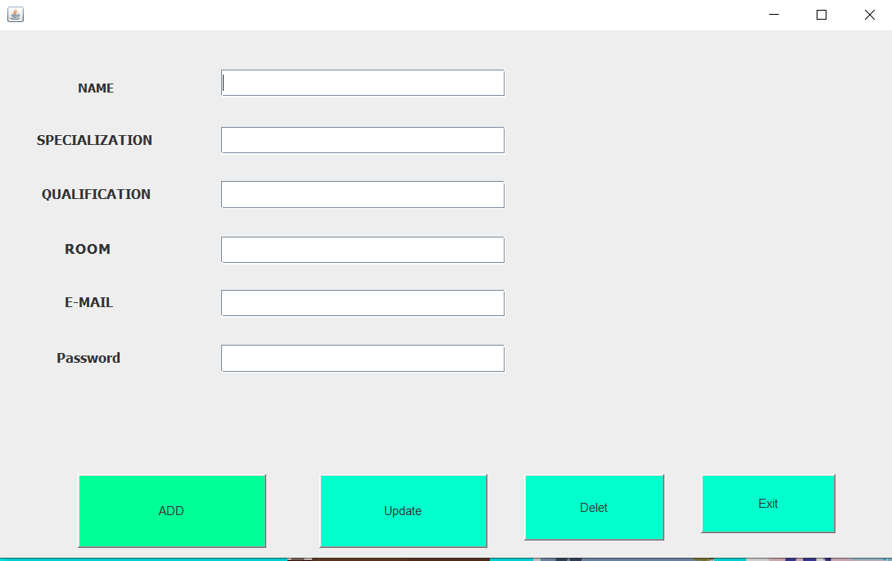
Screen Design
Add Doctor

Slide 15
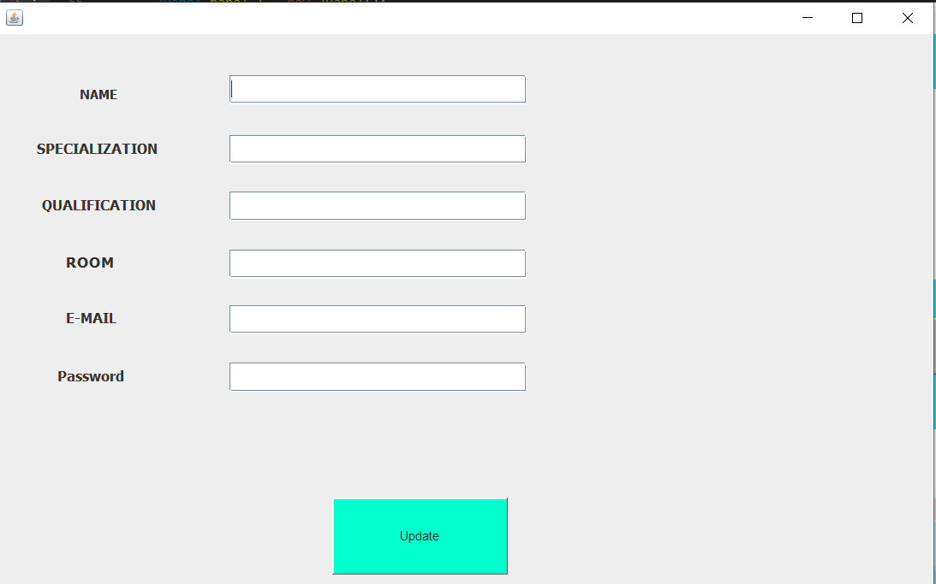
Screen Design
Update Doctor

Slide 16
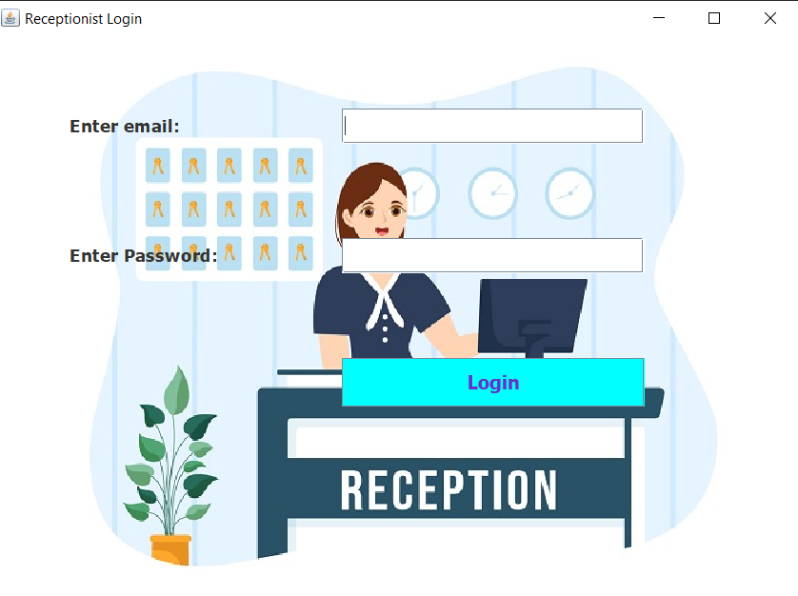
Screen Design
Receptionist Login

Slide 17
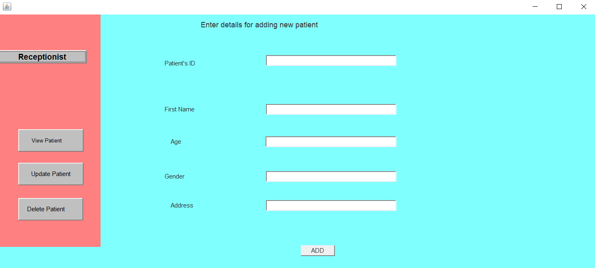
Screen Design
Add Receptionist

Slide 18
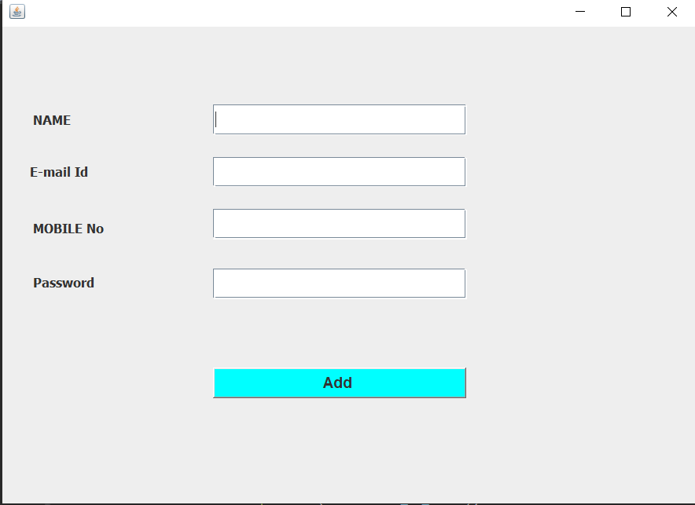
Screen Design
Add Patients

Slide 19
TESTING
TESTING STRATEGIES:
A) Unit testing —
Test individual unit of DC Tested by - Developer
Methodology - Test individual unit of DC
B) Integration and System Testing –
Integration testing test two or more than two integrated models System testing test functional and non-functional user requirement. Tested by - Tester
Methodology - It is used for integrated model, functional and non- functional user requirement.
C) Performance Testing -
It measure performance / response under critical, load and stress condition.
Tested by - Tester
Methodology - Measure performance under critical, stress and load system.
D) Regression Testing -
Used to uncover new errors in existing functionality after changes have been made.
Tested by - Tester
Methodology - Test system response after functional enhancements in existing system.

Slide 20
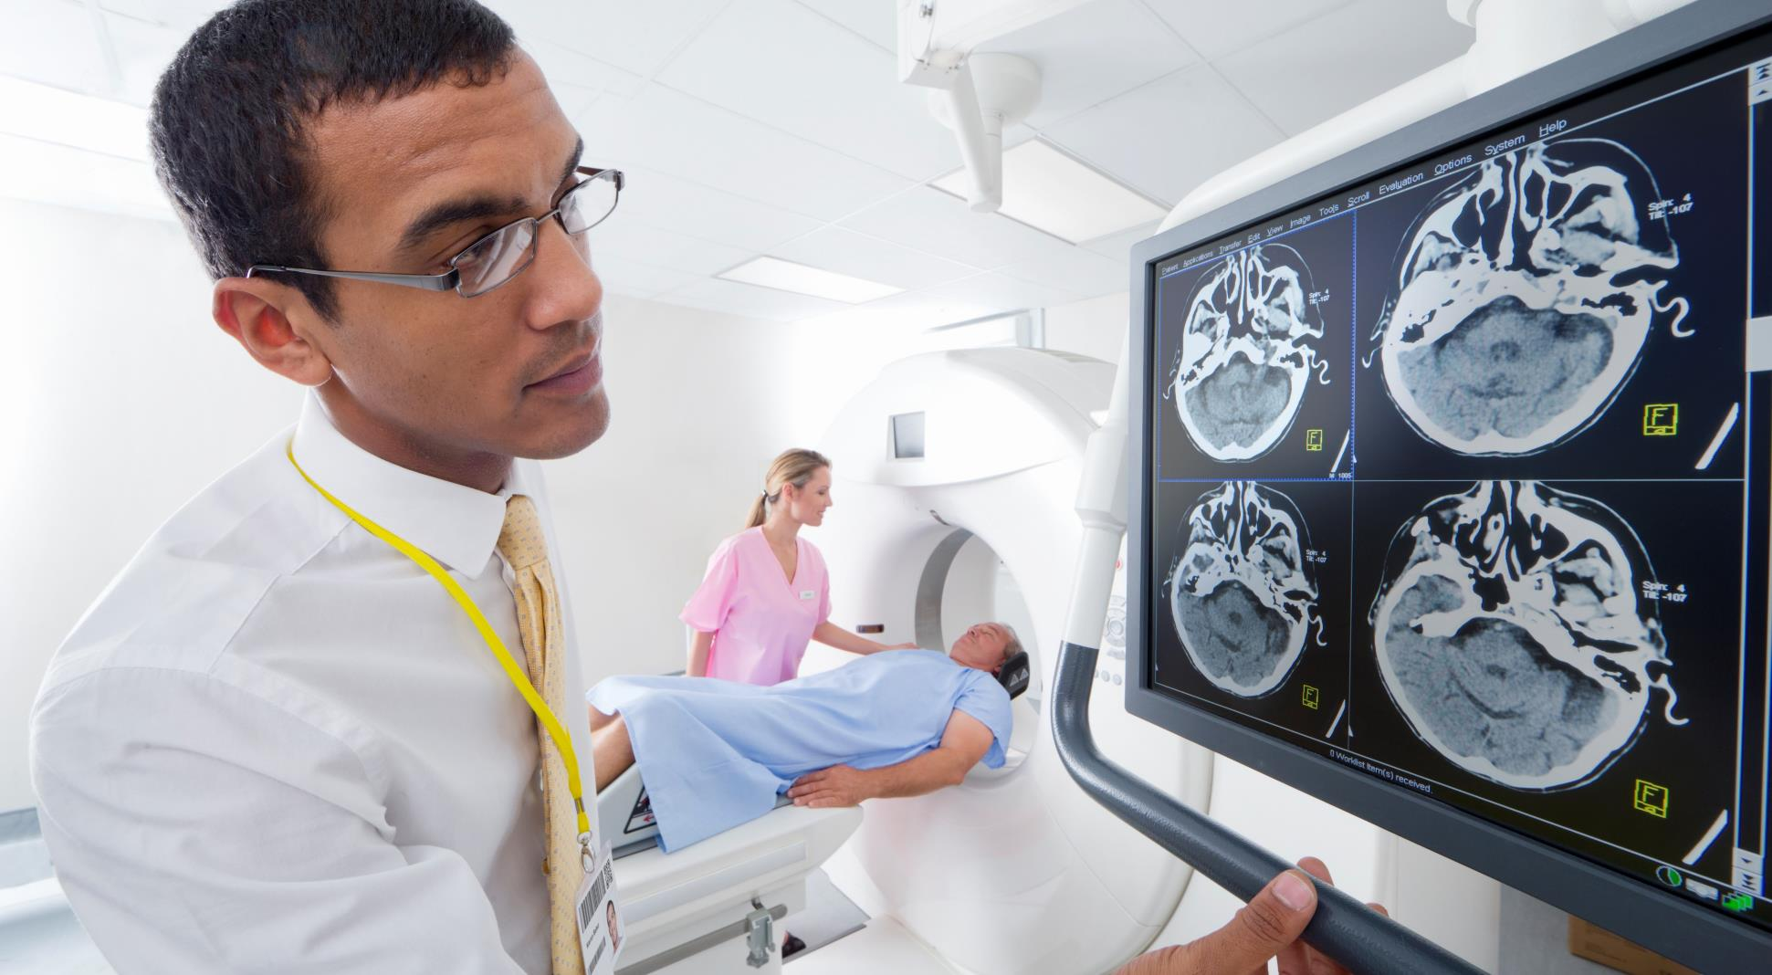
FUTURE SCOPE
The databases in the local machines can be replaced by a central web-based databases which will be used across all branches of the Doctor’s List.
More modules and functionality can be added to aid the management process.
The security of the system can be greatly improved by using cryptography to store passwords and sensitive personal information.
A patient side client can also be introduced in later stages that might simplify tedious tasks for patients such as admission, appointments bill payments etc.

Slide 21

bibliography
SWING DOCUMENTATION https://docs.oracle.com/javase/7/docs/api/javax/swing/package-summary.html
JDBC DOCUMENTATION https://docs.oracle.com/javase/8/docs/technotes/guides/jdbc/
ICONS https://www.flaticon.com/
MySQL DOCUMENTATION https://dev.mysql.com/doc/

Slide 22

THANK YOU

